Slide 1


Assignment 2 – Practical Data Science
Activity Recognition from a Single Chest-Mounted Accelerometer
Varun Ramesh
s3793675

Slide 2

Goals of the Project
To predict the activity of the user based on the accelerometer readings supplied. The data consists of readings from 15 different people and has different activities involved with each of them. The activities to predict are :
Working at Computer
Standing Up, Walking and Going up\downstairs
Standing
Walking
Going Up\Downstairs
Walking and Talking with Someone
Talking while Standing

Slide 3
Data Preparation Steps
15 Datasets are taken, and are imported in different names. These were then given a column heading as none of them had one.
A new column was added in each of them called person. These had the person number.
These 15 datasets were concatenated into one single data frame.
A random sample of 100,000 was taken from the dataset of 1,926,896 rows.
This dataset did not have any null values but there was a label with a value of zero in it which was removed.

Slide 4

Hypothesis
Null Hypothesis : Each of the accelerations in the data is interdependent with the label.
For example:
x axis, y axis acceleration is dependent on forward and backward movement like walking and climbing stairs
z axis acceleration is dependent on upward movement like climbing up the stairs, standing up.
Alternate Hypothesis : The accelerations are not dependent on the label.

Slide 5
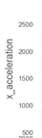
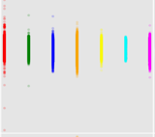
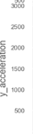
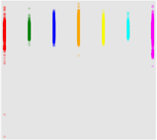
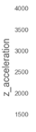
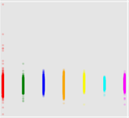
Hypothesis - Continued
Red – Working at the computer
Green – Standing up, walking and Going up/down the stairs
Blue – Standing
Orange – Walking
Yellow – Going up/Down the stairs
Cyan – Walking and talking to someone
Magenta – Talking while standing
Alternate Hypothesis rejected!

Slide 6
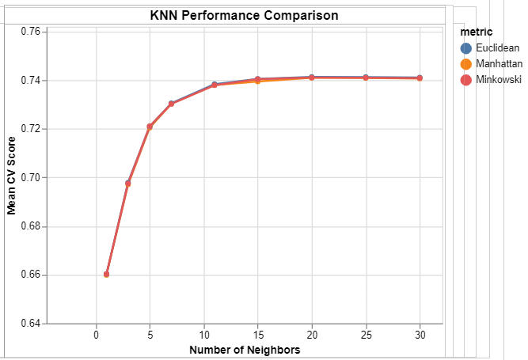
Steps taken for Modelling
Data Preparation
Fitting a classifier : KNN had better scores compared to Decision Tree
Hyper Parameter Tuning : Results for both of them improved considerably but KNN had better results
Accuracy score was found to be 75.6 % after tuning and the best parameters were n neighbours is 20 and p value is 2.

Slide 7

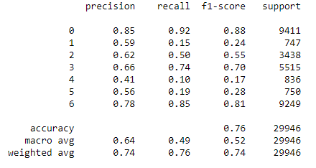
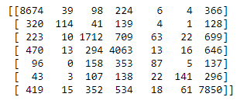
Results and Predictions
Classification Report
Confusion Matrix

Slide 8

Conclusions
KNN’s accuracy increased after hyper parameter tuning
Accuracy for only some labels were good
For the labels without good accuracy, new parameters need to be implemented for better understanding and correlation.

Slide 9

Thank You

